Slide 1
TOPIC 4: SELECTION AND PLACEMENT

Slide 2

1. Personnel selection

Slide 3

The selection process can be defined as the process of selection and shortlisting of the right candidates with the necessary qualifications and skill set to fill the vacancies in an organisation. The selection process varies from industry to industry, company to company and even amongst departments of the same company.

Slide 4

Personnel selection is the methodical process used to hire (or, less commonly, promote) individuals.

Slide 5

The goal of personnel selection, as all business processes, is to ensure an adequate return on investment.

Slide 6

The procedure of personnel selection includes :
Interviews​
Personality Tests​
Biographical Data​
Cognitive Ability Tests​
Physical Ability Tests​
Work Samples​

Slide 7
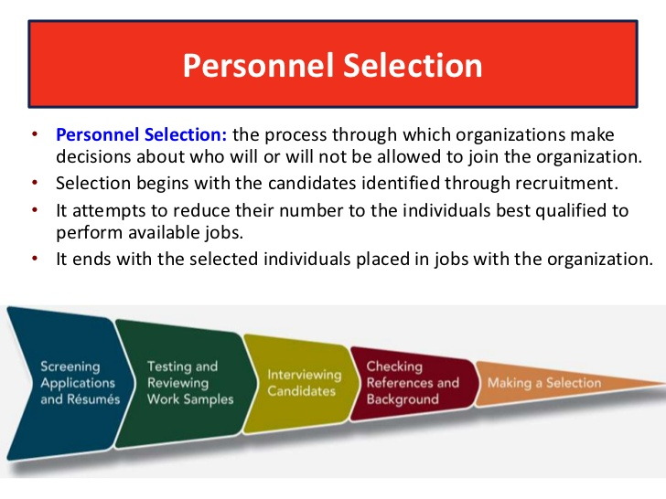

Slide 8
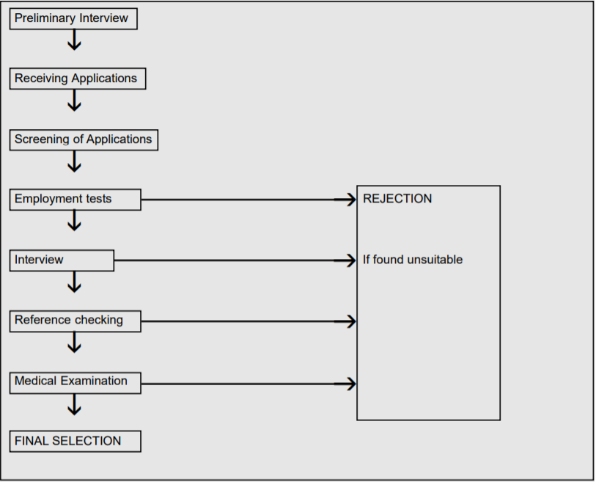
Every organisation creates a selection process because they have their own requirements. Although, the main steps remain the same. So, let’s understand in brief how the selection process works.

Slide 9

8 steps of the selection process for hiring employees

Slide 10

1. Application
The application phase in the selection process is sometimes seen as passive from the hiring team side – you just wait for candidates to respond to your job ad. However, applications can and should be selection tools, helping you sort candidates as qualified or unqualified.
How can you do this? There are two options to get started: qualifying questions and gamification.

Slide 11
Qualifying questions
If you’re using software to build your application forms, using qualifying questions at the beginning of your selection process should be easy. You can add two or three questions relevant to the position. The candidates must answer these questions in order to apply. ​
For example:​
Briefly describe your experience with Excel.​
What’s the difference between content marketing and journalism?​
Some of these questions could require simple yes/no answers with the wrong answer automatically disqualifying a candidate – this is something that can also easily be done via recruitment software. Of course, automatic disqualification should be reserved only for absolute must-have skills. For example, if you’re looking for a senior designer, a disqualifying question could be “Do you have 5+ years of design experience?”​

Slide 12
Help candidates complete your applications
Of course, you want candidates who start completing your forms to actually go all the way and submit their application. Yet, so many candidates abandon applications because it takes too long to complete them or they’re too complicated. To avoid this, here are a few things you can do to streamline this part of the selection process:​
Keep qualifying questions to a minimum and make sure they don’t require complex or long answers.​
Try applying to one of your open roles; that’s how you’ll be able to spot glitches, hurdles or lengthy applications.​
Test your application forms’ (and careers page’s) mobile version. Many people apply via mobile so it needs to work well.​
To see whether there’s an issue with your application forms, you could also track your application abandonment rate. Ideally, you’d like it to be close to 0%, so the higher that number is, the more improvements your applications need.​

Slide 13
Gamification
Gamifying your recruitment process isn’t a new trend, but with the progress of technology, you can now use gamification tools more effectively in the selection process. Especially in the application phase, consider asking less-experienced candidates and those transitioning from different backgrounds to play online or offline games.
The reasoning behind this is that candidates who are recent graduates, or have made a career change, won’t have much relevant experience to showcase in their resumes — despite being possibly the right fit for a job. This can be a problem when you’re trying to evaluate them based on their application. By using gamified assessment methods in the that stage, you can shortlist promising people and your hiring team will have better chances of interviewing only a few truly qualified candidates.
This also gives you an opportunity to diversify your applicant pool when you find the majority of applicants that meet your required background come from a narrow subset or demographic.

Slide 14

2. Resume screening
Now that you have wrapped up the application phase of the employee selection process, you have a collection of resumes or CVs to sift through and filter those deemed suitable for a screening call. What you’ll need to do now is go through resumes one by one, whether manually or software-assisted, and identify prime candidates.
This is one of the most traditional employee selection methods to move candidates to the next step by identifying and disqualifying those who don’t quite fit what you’re looking for.
There may be hundreds – in some cases, thousands – of applicants for a single job. There are numerous ways to filter resumes:

Slide 15
Background
This is a practical side of the selection process; you’re looking for the background that qualifies a candidate for the position you want to fill. You’ll want to know if they have the academic knowledge or professional expertise – or both – to perform a job well.

Slide 16
Resume layout
Even something as simple as the layout of a candidate’s resume can be an indicator of how qualified they are for a position. The skill of organizing and presenting information in a clear and concise way is on full display here.
Consider the following examples of how a resume’s layout can offer a quick demonstration of a candidate’s skill set:
If you’re looking to fill a creative position – such as graphics or web design – the resume layout can be a powerful indicator of how well they can design.
If you’re looking to fill a sales position, the manner in which they present a resume can show you how they might be able to catch your client’s eye with important, relevant information to convert them into buyers.
If you’re looking for a marketing copywriter, the resume shows their ability to describe things in a tight, concise and engaging manner.

Slide 17
Cover letter
Similarly to the resume, a candidate’s cover letter gives you an idea of who they are and what they bring to the role. You’re looking for tightly and smartly written language that clearly describes what they can bring to the position. Does the candidate:
Describe their skills and background in a relevant way to the position being applied for?
Show their knowledge of your company and its goals, and how they can contribute?
Write in a professional, error-free manner that reflects their ability to communicate via email and other channels?

Slide 18
Intangibles
It may initially seem corny to list one’s hobbies and personal interests in a resume, but even those can be great indicators of the kind of person applying for the role. For instance:
“Running” indicates they’re a healthy person and disciplined enough to train for 10Ks or marathons on a regular basis.
“Volunteering” shows they’re interested in the bigger picture (i.e. your company’s mission and vision) and can have the empathy that would make them a great team member.
“Chess” indicates an ability to process complex information in a logical/logarithmic way, an invaluable skill for a developer position

Slide 19
Unconscious bias
As through every step of the employee selection procedures, you want to keep your unconscious bias in check. For example, during the selection process, watch out for potential biases including someone’s name, gender, race, age, class, and even academic background – for instance, just because someone got their MBA from a local college rather than from Harvard doesn’t necessarily make them less worthy of a candidate or their MBA degree less impressive.
If you are like many employers and recruiters, you’re also actively pursuing a D&I initiative. If you’re looking to build a gender-balanced team in a sector dominated by one gender, check out these five steps in which you can do it successfully.

Slide 20

3. Screening call
The screening call, or phone screen, is among the initial hiring stages where recruiters shortlist applicants. The purpose of this call is to establish whether the candidate is truly interested in the job and (at least) minimally qualified to do it successfully. This way, only the best applicants will go to the next, stricter (and more expensive) hiring stages, like assessments and in-person interviews, saving your team time and money.

Slide 21
Schedule a phone screen
The email you’ll send to candidates to schedule a screening call is important; that’s because it may very well be your very first communication with that candidate. So this is your chance of setting the tone of your relationship with that candidate and, who knows, future employee.
In this case, you need to be straightforward and positive, giving out a professional outlook. Thank the candidate for applying to your open role and ask them if they’d like to speak with you so you can get to know them and give them details about the job. Keep it short

Slide 22
Prepare well beforehand
Without being able to see candidates face to face and connect with them or assess their body language, and with the added issues of occasional bad signal or background noise, you might find screening calls difficult to navigate. The key is to prepare thoroughly: know exactly what you’re looking for and what you want to learn about each candidate, as well as what information you’d like to convey, before you begin with the selection process.
Write down your requirements. You probably already know the basic qualifications you’re looking for, so make a list of basic ones you’d like to check during the screening call. These might include “must be able to start work within the month” or “they should want to relocate.” It might be useful to give some thought on what you can be flexible on – for example, would you be able to convert a full-time job to part-time or agree to flexible hours?
Read candidate resumes. This is important for two reasons: you’ll show candidates that you’re serious about their application, and you’ll be able to spot discrepancies you can ask about. For example, if candidates have a huge gap in their employment record, you might ask why that was.
Make sure you can answer basic questions. Candidates will be evaluating your company throughout the recruitment process, just like you’ll be evaluating them. To persuade a good candidate to complete and assessment or come in for an interview, you should pitch the position and your company effectively. Do your homework about the role and refresh your knowledge of the company’s mission.

Slide 23
Select the right questions
The questions you’ll ask should tell you whether the candidate is suitable and interested in the role.
Here are a few example questions:
When could you start if you were offered the job?
Would you be comfortable with 50% travel?
How much money would you like to earn in this position?
What did you find most interesting in the job description?
What interests you about our company?
Tell me about this two-year gap in your resume
Why do you want to leave your current position?
Ask questions and listen carefully to the candidate. Determine whether their attitude suits your company and whether their answers are satisfying. Watch out for answers that may not sound genuine or contradictions with their resume or application.

Slide 24

4. Assessment test
Once you’ve screened candidates and sorted them out into “promising”, “maybe”, and “disqualified” groups, you want to look at the surviving candidates and further assess their ability to do the job you’re looking to fill. These assessments can take place in a multitude of forms in the selection process:
An in-person audition for an acting position, a sales job where you request the candidate to pitch you a product, or a kitchen position where you ask them to cook something for you on the spot.
A written or online test to test for aptitude, personality, intelligence, etc.
A practical skills test to determine a candidate’s typing speed, data entry capabilities, memory, etc.

Slide 25
Navigate the assessment stage effectively
Timing is a consideration. You want to give candidates enough time to complete the assessment – for instance, give them 3-5 business days to complete a short test. Stay close to realistic goals that you might expect of them if they were working in your company; don’t ask them to complete a complex project in a 24-hour span, but don’t give them 20 days either. Communication is key. Explain clearly to candidates the scope and purpose of the assessment, so they understand fully why you’re doing it. You don’t want them thinking you’re asking free work of them. In many cases in this phase of the selection process, you aren’t just looking at a candidate’s ability to do the task at hand; you’re also looking at the way they communicate themselves leading up to, during, and after the assessment. You’ll also want to look at the way they approach the assessment, especially when it comes to creative projects such as in development and design which often require some collaboration and planning.

Slide 26

5. In-person interviewing
You’re now deep in the selection process, having screened candidates, evaluated their skills, assessed their abilities, and created a shortlist of the most qualified people. It’s finally time to meet in person with those promising candidates and determine who’s going to be your next hire.
A good interview will help you make better hiring decisions, as you will objectively evaluate and compare candidates’ potential. But there’s more to do than the actual interview. You need to prepare yourself and the entire hiring team to make sure you ask all the right questions.
More specifically, you should prepare:

Slide 27

A list of job-related questions that assess how well candidates can manage regular job duties. You can ask a mix of:
Role-specific questions, to evaluate candidates’ knowledge and experience
Soft skills questions, to identify candidates who are good not just on paper
Situational questions, to learn how candidates would address different scenarios and issues that may arise on the job
Behavioral questions, to discover how candidates have previously handled professional challenges

Slide 28
Cultural fit questions that will help you pick these candidates who are more likely to thrive in your work environment. For example, you could ask:
Career goals questions, to find candidates whose professional goals align with your business objectives
Collaboration questions, to identify team players
Adaptability questions, to learn which candidates are more flexible and will have a smooth transition to their new role if hired

Slide 29
Schedule interviews at least two or three business days in advance. Surely, if you’ve found the perfect candidate or if you’re in a rush to close an open role, you want to speed up the process. But, calling candidates to ask them to meet on the same or next day could send the wrong message and make you look desperate. Besides, candidates might be working elsewhere, so they need to adjust their schedule. They also need some time to prepare themselves for the interview (e.g. do some research on your company, take a closer look at their assignment, etc.)

Slide 30
Provide candidates all necessary information. This includes:
the exact day and time of the interview, taking into consideration different time zones if you’re interviewing remote candidates
the address of your offices along with directions on how to get there (or, instructions on how to log in to a video platform, in case of a video interview)
the names and roles of the interviewers
the scope of the interview (e.g. “We’ll go over your assignment” or “You’ll meet with the CEO”)
the estimated duration of the interview

Slide 31
Offer candidates a few alternative days for the interview. Busy schedules and multiple interviews and interviewers can make the interview scheduling process very complicated. To save time and avoid back-and-forth emails or double-bookings, let candidates pick the most convenient day and time. You could either share via email your availability (highlighting your preferred three or four time slots) or share your entire calendar through a self-scheduling tool.

Slide 32

6. Background checks
Background checks reassure you that your finalists are reliable and don’t pose risks to your company. For example, employers may conduct pre-employment checks to make sure candidates have told the truth in their resumes or don’t currently do illicit drugs. In fact, there are several types of background checks including:
Criminal records
Credit reports
Driving records
Verification reports (e.g. identity, education, work history, social security number, national insurance number, etc.)
Drug tests

Slide 33

7. Reference checks
In the final stages of the selection process, you might want to get some references for your best candidates. This way, you’ll get feedback about their performance from people they’ve actually worked with in the past, such as former managers, former colleagues or business partners and clients.
During reference checks, you will:
Confirm what candidates have already told you (e.g about time of employment and previous job responsibilities)
Learn how candidates use their skills on the job
Discover potential weaknesses or lack of practical experience
Understand how candidates behave in the work environment (e.g. if they’re punctual, if they receive feedback well, etc.)

Slide 34
2. Selection methods

Slide 35

INTERVIEWS
Unstructured Interview - involves a procedure where different questions may be asked of different applicants

Slide 36

Situational Interview- candidates are interviewed about what actions they would take in various job-related situations.
The job-related situations are usually identified using the critical incidents job analysis technique.

Slide 37

Behavior Description Interviews- candidates are asked what actions they have taken in prior job situations that are similar to situations they may encounter on the job.

Slide 38

Comprehensive Structured Interviews - candidates are asked questions pertaining to how they would handle job-related situations, job knowledge, worker requirements, and how the candidate would perform various job simulations.

Slide 39

Structured Behavioral Interview- This technique involves asking all interviewees standardized questions about how they handled past situations that were similar to situations they may encounter on the job.

Slide 40

Oral Interview Boards - This technique involves asking all interviewees standardized questions about how they handled past situations that were similar to situations they may encounter on the job.

Slide 41
Advantages | Disadvantages
useful for determining if the applicant has requisite communicative or social skills which may be necessary for the job | subjective evaluations are made
interviewer can obtain supplementary information | decisions tend to be made within the first few minutes of the interview with the remainder of the interview used to validate or justify the original decision
used to appraise candidates' verbal fluency | interviewers form stereotypes concerning the characteristics required for success on the job
can assess the applicant's job knowledge | research has shown disproportionate rates of selection between minority and non-minority members using interviews
can be used for selection among equally qualified applicants | negative information seems to be given more weight
enables the supervisor and/or co-workers to determine if there is compatibility between the applicant and the employees | not much evidence of validity of the selection procedure
allows the applicant to ask questions that may reveal additional information useful for making a selection decision | not as reliable as tests
the interview may be modified as needed to gather important information

Slide 42
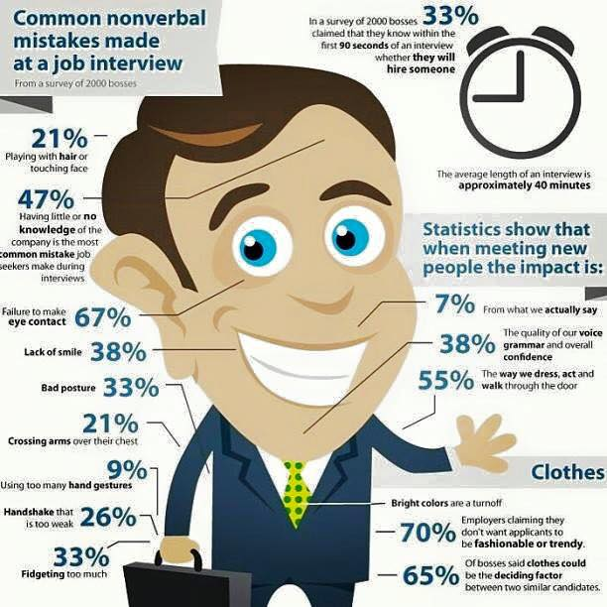

Slide 43
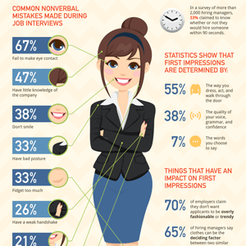

Slide 44
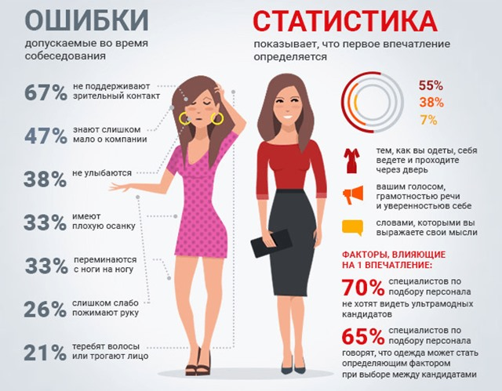

Slide 45
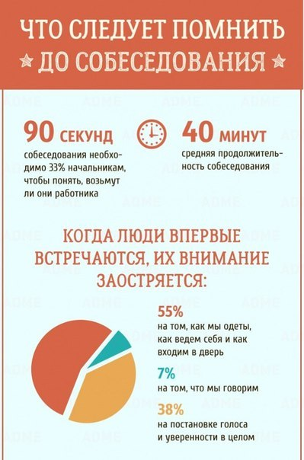
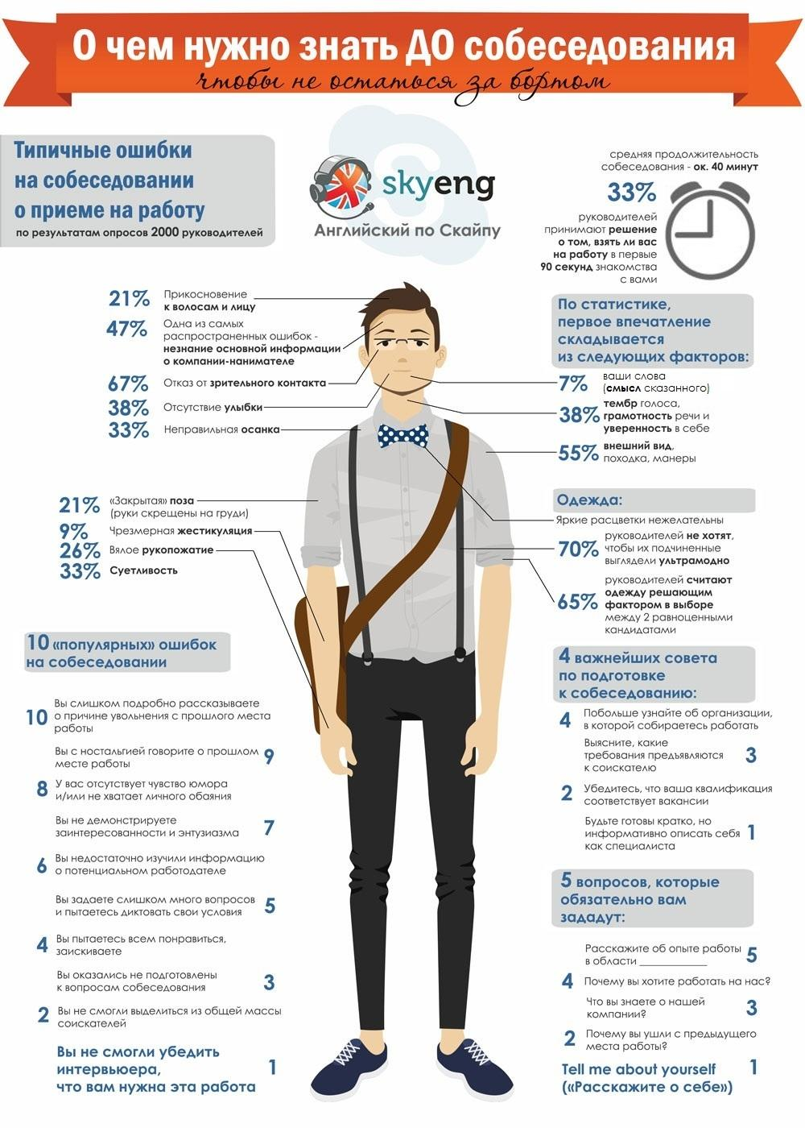

Slide 46
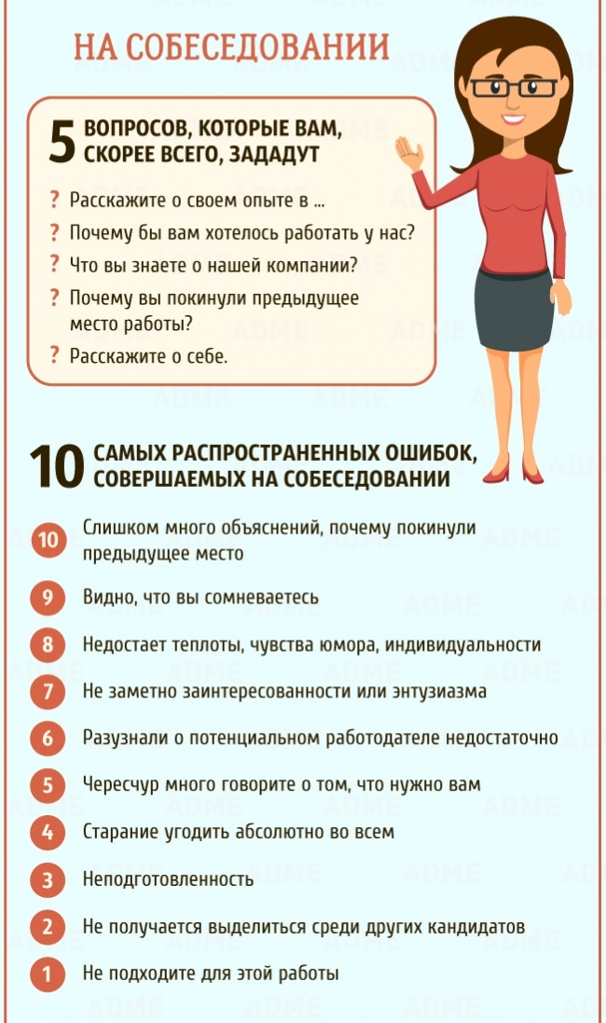

Slide 47
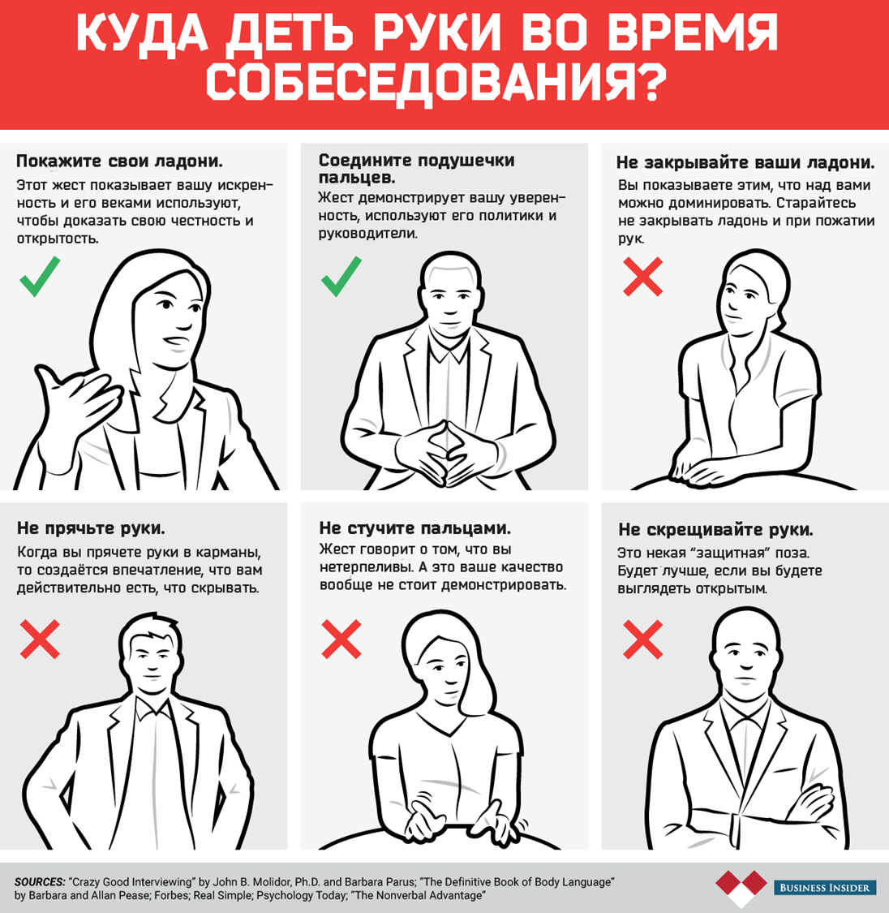

Slide 48
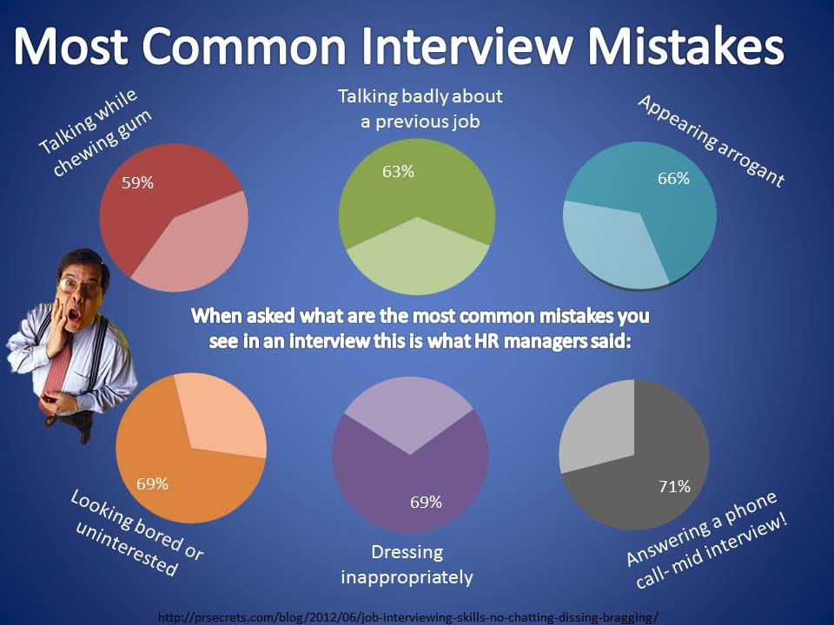

Slide 49
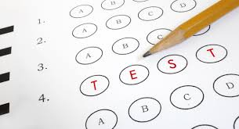
PERSONALITY TESTS
Personal Attribute Inventory - a set of tests and tasks for identifying the type of temperament and key character traits

Slide 50

Personality Adjective Checklist- a comprehensive, objective measure of eight personality styles.

Slide 51
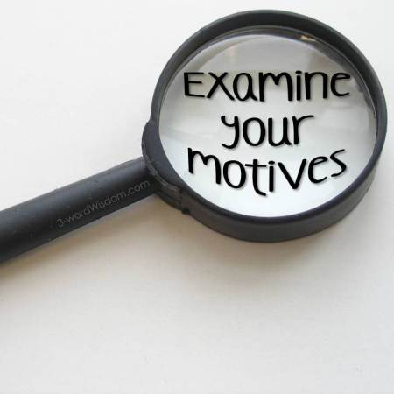
Motives Questionnaires- It is used for the diagnosis of two generalized persistent motives of the personality: the motive of the desire for success and the motive for avoiding failure.

Slide 52

Interests Questionnaires - focused on the definition of educational and professional interests.

Slide 53
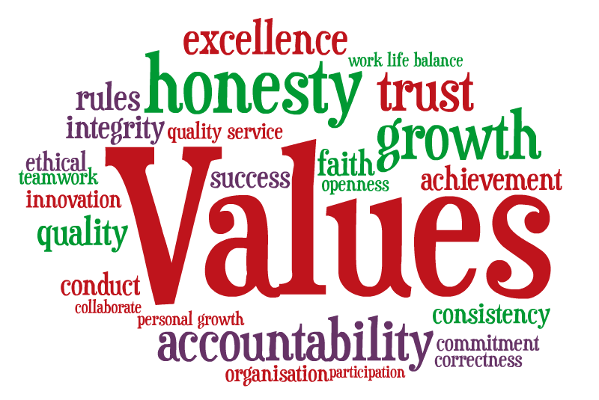
The questionnaires of values - values and value orientations are considered as criteria used by people to select and justify their actions, as well as to assess themselves, other people and events.

Slide 54

Questionnaires adjustment - determine the expressed tendency of the individual to positively or negatively react to a certain class of incentives, situations, events.

Slide 55
Advantages | Disadvantages
can result in lower turnover due if applicants are selected for traits that are highly correlated with employees who have high longevity within the organization | difficult to measure personality traits that may not be well defined
can reveal more information about applicant's abilities and interests | applicant's training and experience may have greater impact on job performance than applicant's personality
can identify interpersonal traits that may be needed for certain jobs | responses by applicant may be altered by applicant's desire to respond in a way they feel would result in their selection
 | lack of diversity if all selected applicants have same personality traits
 | cost may be prohibitive for both the test and interpretation of results
 | lack of evidence to support validity of use of personality tests

Slide 56
BIO DATA
The content of biographical data instruments varies widely, and may include such areas as leadership, teamwork skills, specific job knowledge and specific skills (e.g., knowledge of certain software, specific mechanical tool use), interpersonal skills, extraversion, creativity, etc.

Slide 57
Advantages | Disadvantages
useful for jobs where a large number of employees are performing the same or similar job | may lead to individuals responding in a way to create a positive decision outcome rather than how they really are (i.e., they may try to positively manage their impression or even fake their response).
useful for jobs where there are a large number of applicants relative to the number of openings
can be administered via paper and pencil or computerized methods easily to large numbers | do not always provide sufficient information for developmental feedback (i.e., individuals cannot change their past).
can be cost effective to administer.
have been demonstrated to produce valid inferences for a number of organizational outcomes (e.g., turnover, performance). | can be time-consuming to develop if not purchased off-the-shelf.
can reduce business costs by identifying individuals for hiring, promotion or training who possess the needed skills and abilities.

Slide 58
COGNITIVE ABILITY TESTS
Advantages | Disadvantages
highly reliable | non-minorities typically score one standard deviation above minorities which may result in adverse impact depending on how the scores are used in the selection process
verbal reasoning and numerical tests have shown high validity for a wide range of jobs
the validity rises with increasing complexity of the job | differences between males and females in abilities (e.g., knowledge of mathematics) may negatively impact the scores of female applicants
combinations of aptitude tests have higher validities than individual tests alone
may be administered in group settings where many applicants can be tested at the same time
scoring of the tests may be completed by computer scanning equipment
lower cost than personality tests

Slide 59
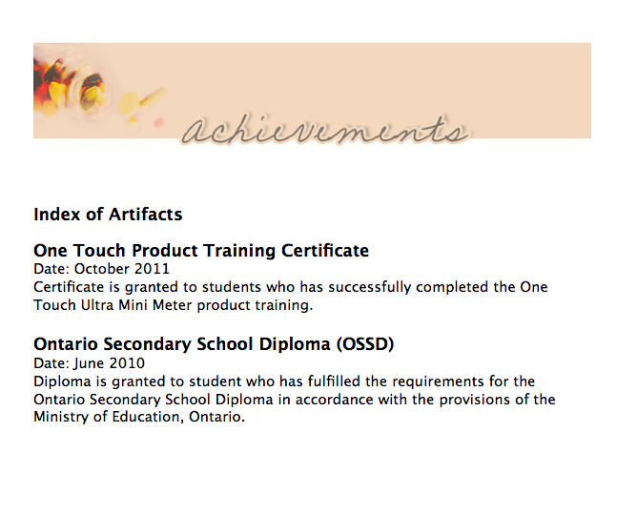
WORK SAMPLE TESTS
Portfolio of achievements - the emphasis is placed on documents confirming success in a certain type of activity

Slide 60

Thematic portfolio - presentation of creative works.

Slide 61

Presentational portfolio - created for presentation at the time of employment, admission to educational institutions

Slide 62

Integrated portfolio - contains all the elements of the above types of portfolios

Slide 63
Advantages | Disadvantages
high reliability | costly to administer; often can only be administered to one applicant at a time
high content validity since work samples are a sample of the actual work performed on the job
low adverse impact | although useful for jobs where tasks and duties can be completed in a short period of time, these tests have less ability to predict performance on jobs where tasks may take days or weeks to complete
because of their relationship to the job, these tests are typically viewed more favorable by examinees than aptitude or personality tests | less able to measure aptitudes of an applicant thus restricting the test to measuring ability to perform the work sample and not more difficult tasks that may be encountered on the job
difficult for applicants to fake job proficiency which helps to increase the relationship between
score on the test and performance on the job
Work Sample tests use equipment that is the same or substantially similar to the actual equipment used on the job

Slide 64
PHYSICAL ABILITIES TESTS
Advantages | Disadvantages
can idendentify individuals who are physically unable to perform the essential functions of a job without risking injury to themselves or others | costly to administer
can result in decreased costs related to disability/medical claims, insurance, and workers compensation
decreased absenteeism | requirements must be shown to be job related through a thorough job analysis
 | may have age based disparate impact against older applicants

Slide 65

SELF-ASSESSMENTS
This technique involves applicants generating self-ratings on relevant performance

Slide 66

ASSESSMENT CENTERS
An Assessment Center consists of a standardized evaluation of behavior based on multiple evaluations including: job-related simulations, interviews, and/or psychological tests.

Slide 67
3. Employee placement

Slide 68

PLACEMENT it’s the distribution of available staff and units of management and other units, taking into account the requirements where they could most effectively work.

Slide 69
The information given during the orientation programme includes:
Employee’s layout
Type of organizational structure
Departmental goals
General rules and regulations
Standing Orders
Grievance system or procedure

Slide 70

PRINCIPLES OF PLACEMENT
1. Man should be placed on the job according to the requirements of the job.

Slide 71

2. The job should be offered to the person according to his qualification.

Slide 72

3. The employee should be made conversant with the working conditions prevailing in the organization and all things relating to the job.

Slide 73

4. While introducing the job to the new employees, an effort should be made to develop a sense of loyalty and cooperation in him so that he may realize his responsibility better towards the job and the organization.

Slide 74

5. The placement should be ready before the joining date of the newly selected person.

Slide 75

6. The placement in the initial period may be temporary as changes are likely after the completion of training.

Slide 76

PROBLEMS OF THE PLACEMENT
1. Independent Jobs: In the independent jobs the non-overlapping territories are allocated to each employee e.g., in the sales.

Slide 77

2. The dependent jobs may be sequential or pooled.

Slide 78

3. In the pooled jobs, there is a high interdependence among the jobs. The final output is the result of the contribution of all the workers.

Slide 79
Lection is over! Thank you for your attention!

